Slide 1






Workshop on the integration of energy scenarios into LCA
Side event LCM 2017 - Wednesday 6th of September 2017

Slide 2
Introduction : three important layers in prospective LCA
Single technology, technosphere only
Regional or global, technosphere only
Regional or global, technosphere and biosphere
Change of the technologies: energy and/or material efficiency, direct emissions, lifetime, recycling rate at the end of life, etc.
Change of composition of market mixes: electricity generation, transportation, and other non-energy sectors.
Larger changes affecting the system as whole or part of it : negative effects from upcoming environmental degradations (e.g. ore grade degradations, negative climate change effects on infrastructure, etc.), or general industrial trends (e.g. increase in recycling rates, improved tailing treatments, increase material efficiency etc).

Slide 3
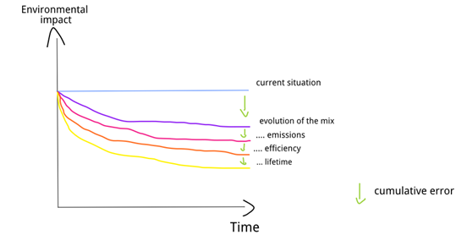
Use energy scenarios in prospective LCA
Energy scenarios can be integrated into LCA to model energy systems that are more representative of future situations:
Information about energy mixes (layer2)
Change about single technologies from
technological info available in the model (layer 1)
Energy is a hotspot in many LCAs, this is transferrable to other sectors (e.g. transportation, agriculture, etc.) and vice versa.

Slide 4
Objectives of the workshop
To determine what has already been done in terms of reusable modules to integrate energy scenarios into LCA, what are the overlaps and complementarities between the existing projects
To identify the current issues and challenges
To exchange ideas to solve these and to establish a roadmap with short-term/medium-term/long-term goals to create an open framework for the integration of energy scenarios into LCA. Share the work to take this further.

Slide 5
Structure of the workshop
Short presentations about recent works on the topic (30 minutes)
Discussions + address the objectives (1 hour)

Slide 7
Update marginal electricity mixes in ecoinvent 3.4
Laurent Vandepaer - Wednesday 6th of September 2017

Slide 8
Update of the marginal electricity supply mixes in ecoinvent 3.4
Marginal electricity supply mixes provided in previous versions of the ecoinvent database were based on historical data.
Objectives:
Provide marginal mixes based on energy scenarios to take into account future market trends and constraints (i.e. which technologies are growing the most)
Perform several sensitivity analyses to understand the influence of the key parameters and methodological choices on the mix composition.

Slide 9
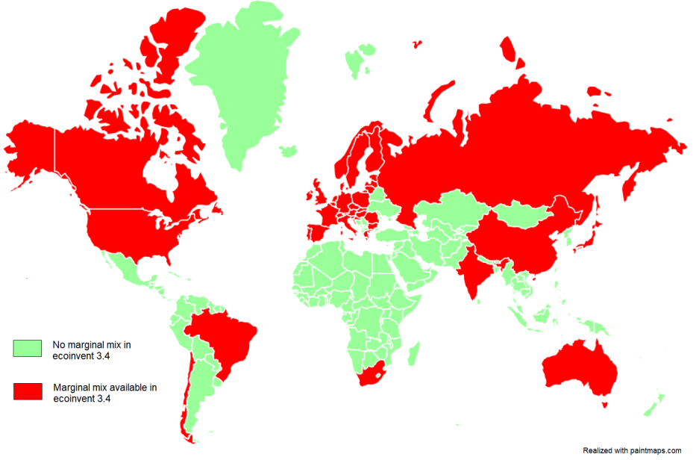
Update of the marginal electricity supply mixes in ecoinvent 3.4
Compilation of public energy scenarios from 40 different countries to calculate the marginal electricity supply mixes.
Covering ~76.5 % of the global electricity production in 2015.

Slide 10
Challenges
Diversity in the origin of the scenarios and their underlying assumptions: use of « current policy » as a comon storyline.
High-level of aggregation in terms of technology in comparison to the technological detail in ecoinvent :
Disagregation based on current data to split coal and hydro technologies.
Disagregation based on scenarios for wind to split into onshore and offshore.
Expert judgement to realize a one to one mapping of the technologies.

Slide 11
What is reusable ?
Mapping table to connect mainstream scenarios to ecoinvent technologies: IEA, European Commission, Energy Information Administration, etc.
Prospective average mixes from these scenarios for 2020, 2030, 2040 and 2050.
BW2 tools (from Wurst Package developed by Brian Cox and Chris Mutel) to transfer electricity mixes from an excel table to generate several version of Ecoinvent (more details https://wurst.readthedocs.io/marginals.html).

Slide 12
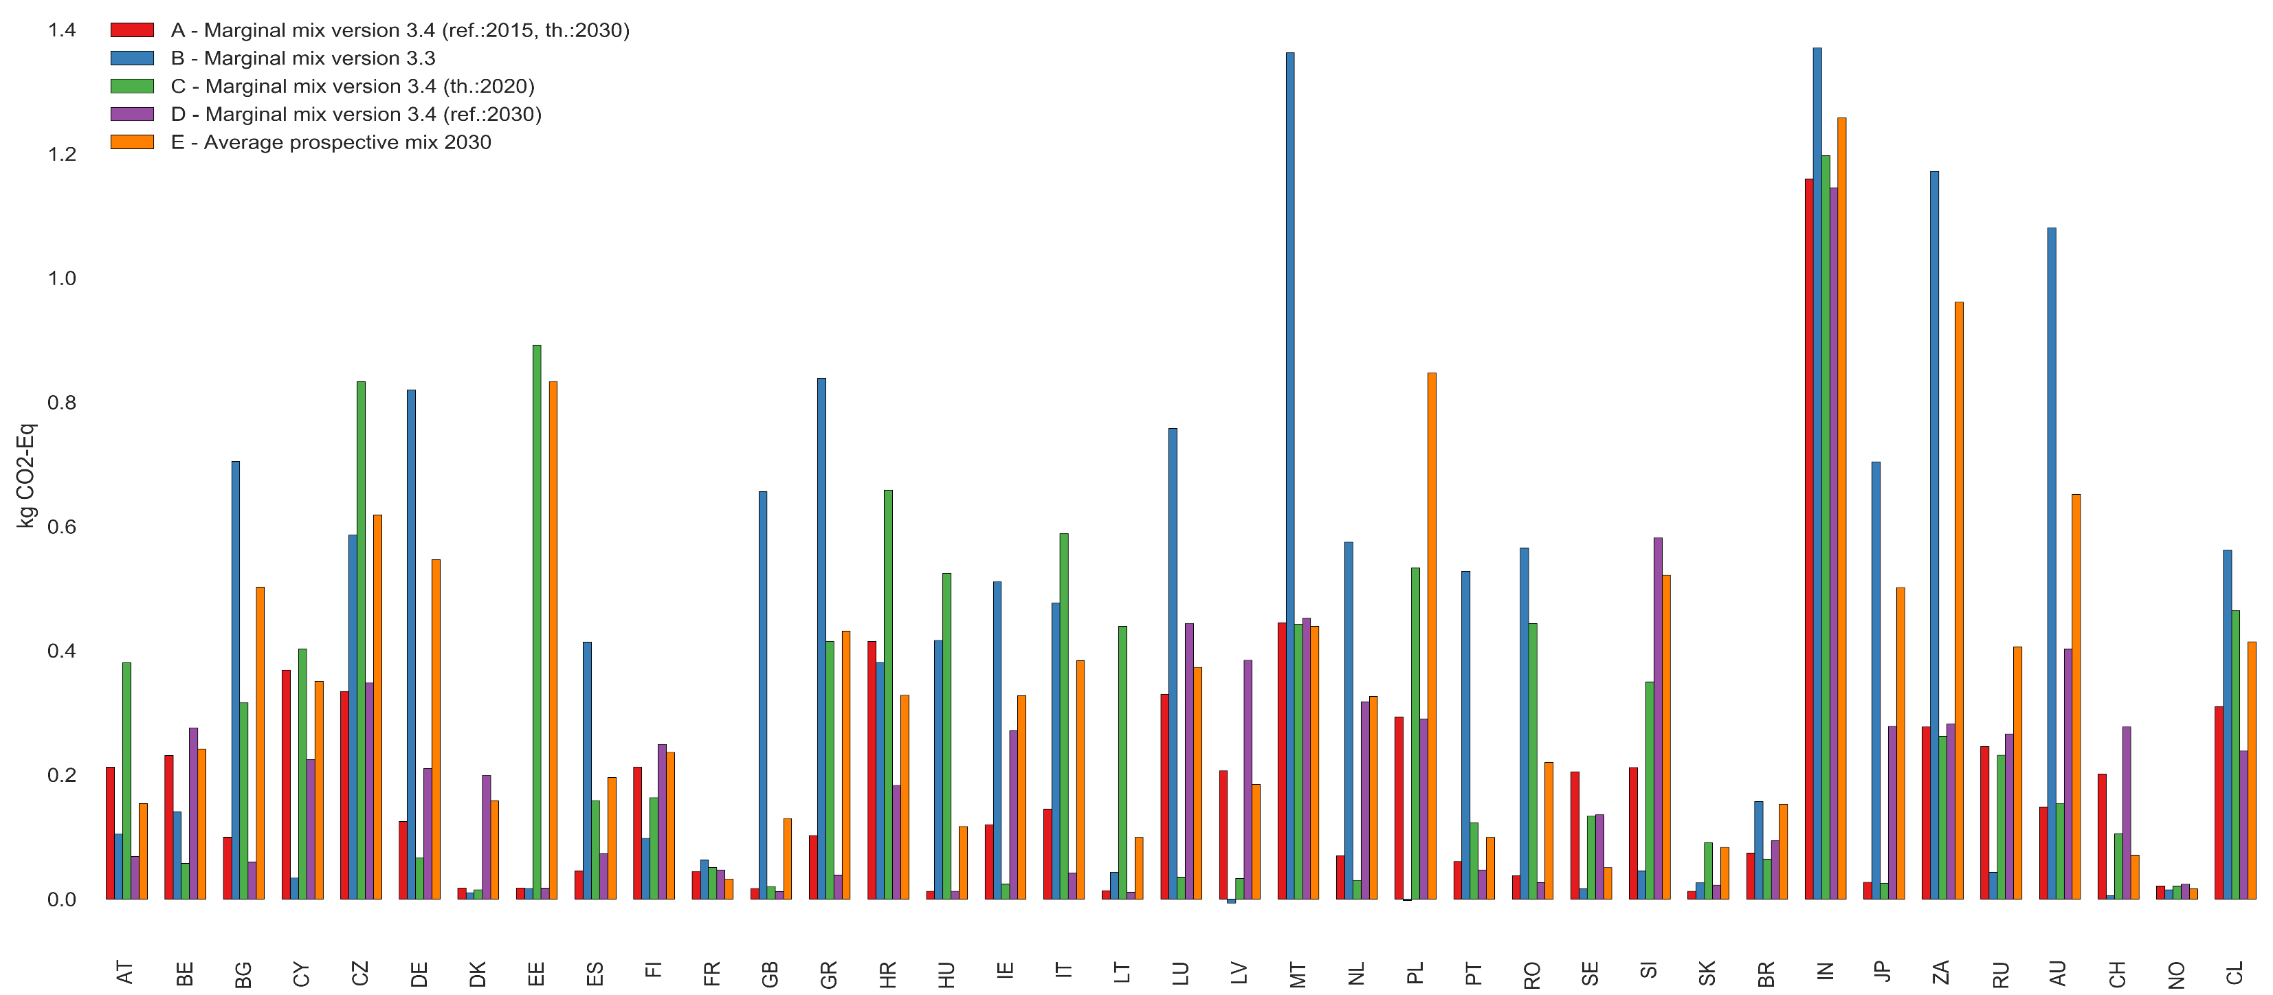
Results
Comparison the global warming potential (IPCC 2013, GWP 100a) of the marginal mixes calculated through the various approaches for a set of country.

Slide 14


Feedback on the integration of IEA scenarios in hybrid LCA
Thomas Gibon - Wednesday 6th of September 2017
+

Slide 15
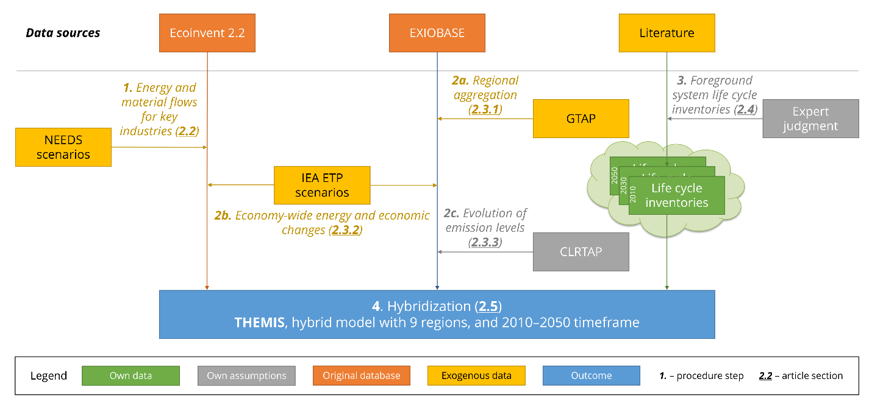
The idea

Slide 16
The implementation
1: A_{ff}
3: A_{fb}
2: A_{bf}
4: A_{bb}
5: value added
6: stressors

Slide 17
Quadrant 1: A_{ff}
1
15 technologies are made of a set of 37 systems, representing the market
For all 9 regions
Diagonal quadrants contain physical information on foreground processes
Systems do not interact with each other at that point (off-diagonal quadrants are zero matrices)

Slide 18
Quadrant 2: A_{bf}
2
Linkage between databases and own systems
For all 9 regions
Diagonal quadrants contain physical information on foreground processes
Systems do not interact with each other at that point (off-diagonal quadrants are zero matrices)
…BUT some inventories are modified a posteriori to be connected with more regions
foreground
ecoinvent
EXIOBASE

Slide 19
Quadrant 3: A_{fb}
3
Feedback loop integrating the systems back to the databases
For all 9 regions
Sparse matrices linking systems’ functional units with processes/sectors of the background
Price and market share adjustments

Slide 20
Quadrant 4: A_{bb}
4
Regionalised ecoinvent databases (orange) and MRIO (purple)
For all 9 regions
Electricity mix is adapted in “each ecoinvent”
Processes/sectors represented by a foreground system have their inputs zeroed out
Other adjustments for 2030 and 2050

Slide 21
«Quadrant» 6: stressors
6
Processes/sectors represented by a foreground system have their stressors zeroed out
For all 9 regions
Other adjustments for 2030 and 2050
Decrease of emissions
Higher industry efficiency

Slide 22
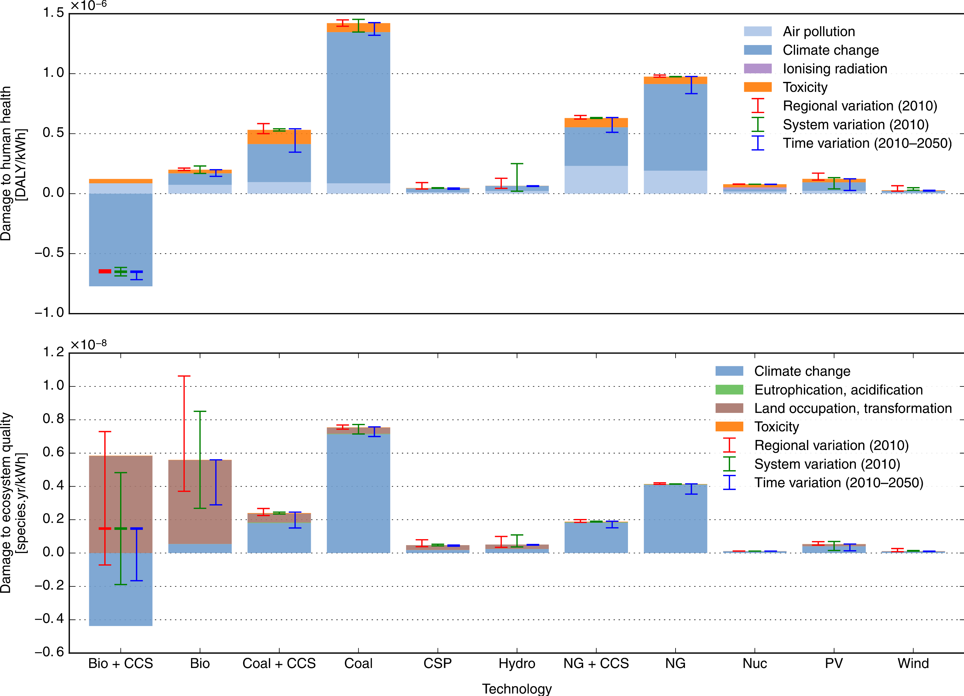
Results

Slide 23
Challenges
Data missing: technologies non commercially available are not in current LCI databases (e.g. carbon dioxide capture and storage),
Matching is made by hand and arbitrarily for the regional level of a technology (e.g. assuming coal power in India can be represented by coal power in Poland),
Disaggregation: within the increasing market share of an emerging technology, no data on exact technical systems involved (e.g. shares of poly-Si, CdTe, CIGS, etc. have been “guestimated”)
Uncertainty is not addressed at all (only variability is)

Slide 25

Integrating TIMES in LCA, feedback and challenges
Miguel Fernandez Astudillo - Wednesday 6th of September 2017

Slide 26
Existing literature
Not new but picking up
With exceptions, most of the studies are attributional * and covering only the electricity sector ⁺.
Considerable differences in the level of integration between TIMES and LCA in each model.
“Deep” integration (i.e. 1 LCI activity per TIMES process) has only been achieved for “small” models (up to 192 tech).
Volkart et al 2017 *
Levasseur et al 2017 *
García-Gusano et al 2016a ⁺ *
Garcia-Gusano et al 2016b ⁺
Tokimatsu et al. 2016 ⁺*
Hertwich et al. 2015 ⁺*
Menten et al. 2015
Choi et al. 2012 ⁺ *
Pietrapetrosa et al. 2009 *
New projects
Reem
Reflex
Store&go

Slide 27
Linking ESM and LCI
Gas furnace
Detached houses
Detach. house
heat
Natural gas
Gas CHP plant
Household heating demand
Heating value
Conv. Gas extraction
Gas pipeline
Gas furnace
Efficiency
Emission factors
Demand
Household cooling demand
Unconv. Gas extraction
Heat pump
Dry gas
Industrial heating demand
Wet gas
Gas in ground
Electricity
Home heating
shale gas ground
Home cooling
Industrial heating
NATEM process
Ecoinvent process
Extraction
Transformation
Final end-uses
Complete but not accurate!
(Changes in the background)
$${Output}_{CLCA}={Output}_{conterfactual}−{Output}_{baseline}$$
Notes:
Here is a representation of the energy supply chain in Natem, it is like the product system in LCA. The process goes as follows
If we do a zoom into one of this processes you will have something like this, a gas furnace for detached houses, it provides heat and it receives natural gas. To do an inventory you could find an LCI of a equivalent process. Adapt the parameters so it is consistent and use the difference in output of that process between two scenarios to create a CLCA inventory.
If you do this for all the final demands You will have a complete inventory, but not necessarily a representative one. Because other things change upstream. And your LCI is representative of 2011, not the modelled period
RES in TIMES = product system in LCA
1) Find valid LCI proxy
2) Adapt it:
Origin of gas
Efficiency
Emission factors
…

Slide 28
Some challenges for deep integration
Too many processes -> one to one mapping may be unfeasible.
Double counting (e.g. cement industry not linked to infr. Development)
Different temporal scope -> parameters defining processes require updating
Dynamic vs static parameters -> in TIMES parameters can change over time
Multifunctional processes

Slide 29
What is reusable:
Strategies to simplify the integration (and the implementation!).
Better documented replicable procedures with common language
Lists of equivalences (proxy LCI – TIMES process)
LCI derived from integration efforts (e.g. NEEDS)
PS: TIMES has its own limitations that may require further linking with other models (e.g. time resolution)

Slide 31

Integration of energy scenarios in Swiss mobility assessment
Didier Beloin-Saint-Pierre - Wednesday 6th of September 2017

Slide 32
Case study
Scope and assumptions of the current LCA model
Electricity production in Switzerland by source as shown in legend of figures
Database: ecoinvent 3.3 cut-off
Future scenarios based on Swiss TIMES model [1]
BAU: Business-as-usual – Current policies & no net import of electricity
LC60: Low carbon 60 – Meets requirements of new Swiss energy policy
LCIA method: GWP from IPCC 2013, time horizon = 100 years
Steps for considering the prospective data from TIMES in LCA model
Choosing the relevant TIME models and scenarios
Mapping the TIMES data
Mapping the ecoinvent v3.3 cut-off dataset
Creating datasets/scenarios for 2020, 2030, 2040 and 2050
Running LCA calculations
[1] 1. Kannan R, Hirschberg S (2016): Interplay between electricity and transport sectors – Integrating the Swiss car fleet and electricity system. Transportation Research Part A: Policy and Practice 94, 514–531

Slide 33
Challenges
Comprehensive list of usable prospective modelling methods is missing
Linking the model to the question
Which assumptions should be mentioned?
What is the consequential mix for the future in relation to the assessed process
Listing the hypotheses for future marginal mixes
Should we always link to a marginal mix during a lifecycle
Getting the data
Is there enough in open access databases/models?
No standard for mapping scenario outputs to inputs of LCA models
General strategy or updatable mapping files
Aggregation / Disaggregation / Missing information

Slide 34
Challenges
Considering the evolution of mixes/technologies in the models
Dynamic LCA and temporally differentiated LCI
Which parameters to modify in technology proxies for the future
Limit to our assessment: paradigm shifts
Defining temporal uncertainty and variability for the future
Modification to pedigree matrix based on statistics per technology
Choosing the LCIA methods
Are methods still valid for the future (temporal horizons - period of validity – update rates)

Slide 36
Integrating IMAGE results in LCA with the WURST Python package
Brian Cox - Wednesday 6th of September 2017

Slide 37
Approach
Ecoinvent
IMAGE
Additional technologies
Import data
Import data
Other
Electricity generation
Electricity markets
Efficiency dependant
Direct emissions
Scale by ∆ efficiency
Replace Value
Modify market share
Wurst
Brightway
Relink future ecoinvent
Future Ecoinvent
LCA Calculations
https://github.com/cmutel/wurst
Notes:
Import /export
filtering
scale exchanges

Slide 38
Updating coal fired electricity plants
Technosphere
market for NOx retained by selective catalytic reduction
market for SOx retained in hard coal flue gas desulfurisation
market for SOx retained in lignite flue gas desulfurisation
market for chlorine gaseous
market for hard coal
market for hard coal ash
market for hard coal power plant
market for light fuel oil
market for lignite
market for lignite ash
market for lignite power plant
market for petroleum coke
market for residue from cooling tower
market for transport freight sea transoceanic
market for water completely softened from decarbonised water at user
market for water decarbonised at user
market group for light fuel oil
Biosphere
Acenaphthene | Ethene tetrachloro- | Phenol
Acrolein | Formaldehyde | Polonium-210
Actinides radioactive | Furan | Potassium-40
Aldehydes unspecified | Hexane | Propane
Antimony | Hydrocarbons aliphatic alkanes cyclic | Propene
Arsenic | Hydrocarbons aliphatic alkanes | Protactinium-234
Barium | Hydrocarbons aliphatic unsaturated | Radium-226
Benzene | Hydrocarbons chlorinated | Radium-228
Benzene ethyl- | Hydrogen chloride | Radon-220
Benzo(a)pyrene | Hydrogen fluoride | Radon-222
Beryllium | Iodine | Sulfur dioxide
Boron | Lead | Selenium
Bromine | Lead-210 | Strontium
Butane | Magnesium | Styrene
Cadmium | Manganese | Sulfate
Carbon dioxide fossil | Mercury | Thorium-228
Carbon disulfide | Methane | Thorium-230
Carbon Monoxide | Methane dichloro- HCC-30 | Thorium-232
Chloroform | Methane monochloro- R-40 | Thorium-234
Chromium | Molybdenum | Toluene
Chromium VI | NMVOC | Uranium-234
Cobalt | Nickel | Uranium-238
Copper | Nitrogen oxides | Vanadium
Cumene | PAH | Water
Cyanide | Particulates < 2.5 um | Water
Dioxins | Particulates > 10 um | Xylene
Ethane | Particulates > 2.5 um and < 10um | Zinc
Ethane 12-dichloro- | Pentane

Slide 39
Updating Electricity Markets - Difficulties
Not all Image technologies in ecoinvent
CSP will be in ecoinvent 3.4
CCS technologies from CARMA project
Take proxies for «unimportant» technologies
More than 1 ecoinvent dataset matches image technology
Example: coal = hard coal and lignite
assume equal share of all technologies available in the market
No ecoinvent dataset in that region!
Go up one regional level
Had to simplify low and medium voltage levels
Assume all technology contribute to high voltage
CCS & IGCC Datasets: Volkart et al. 2013: DOI: 10.1016/j.ijggc.2013.03.003

Slide 40
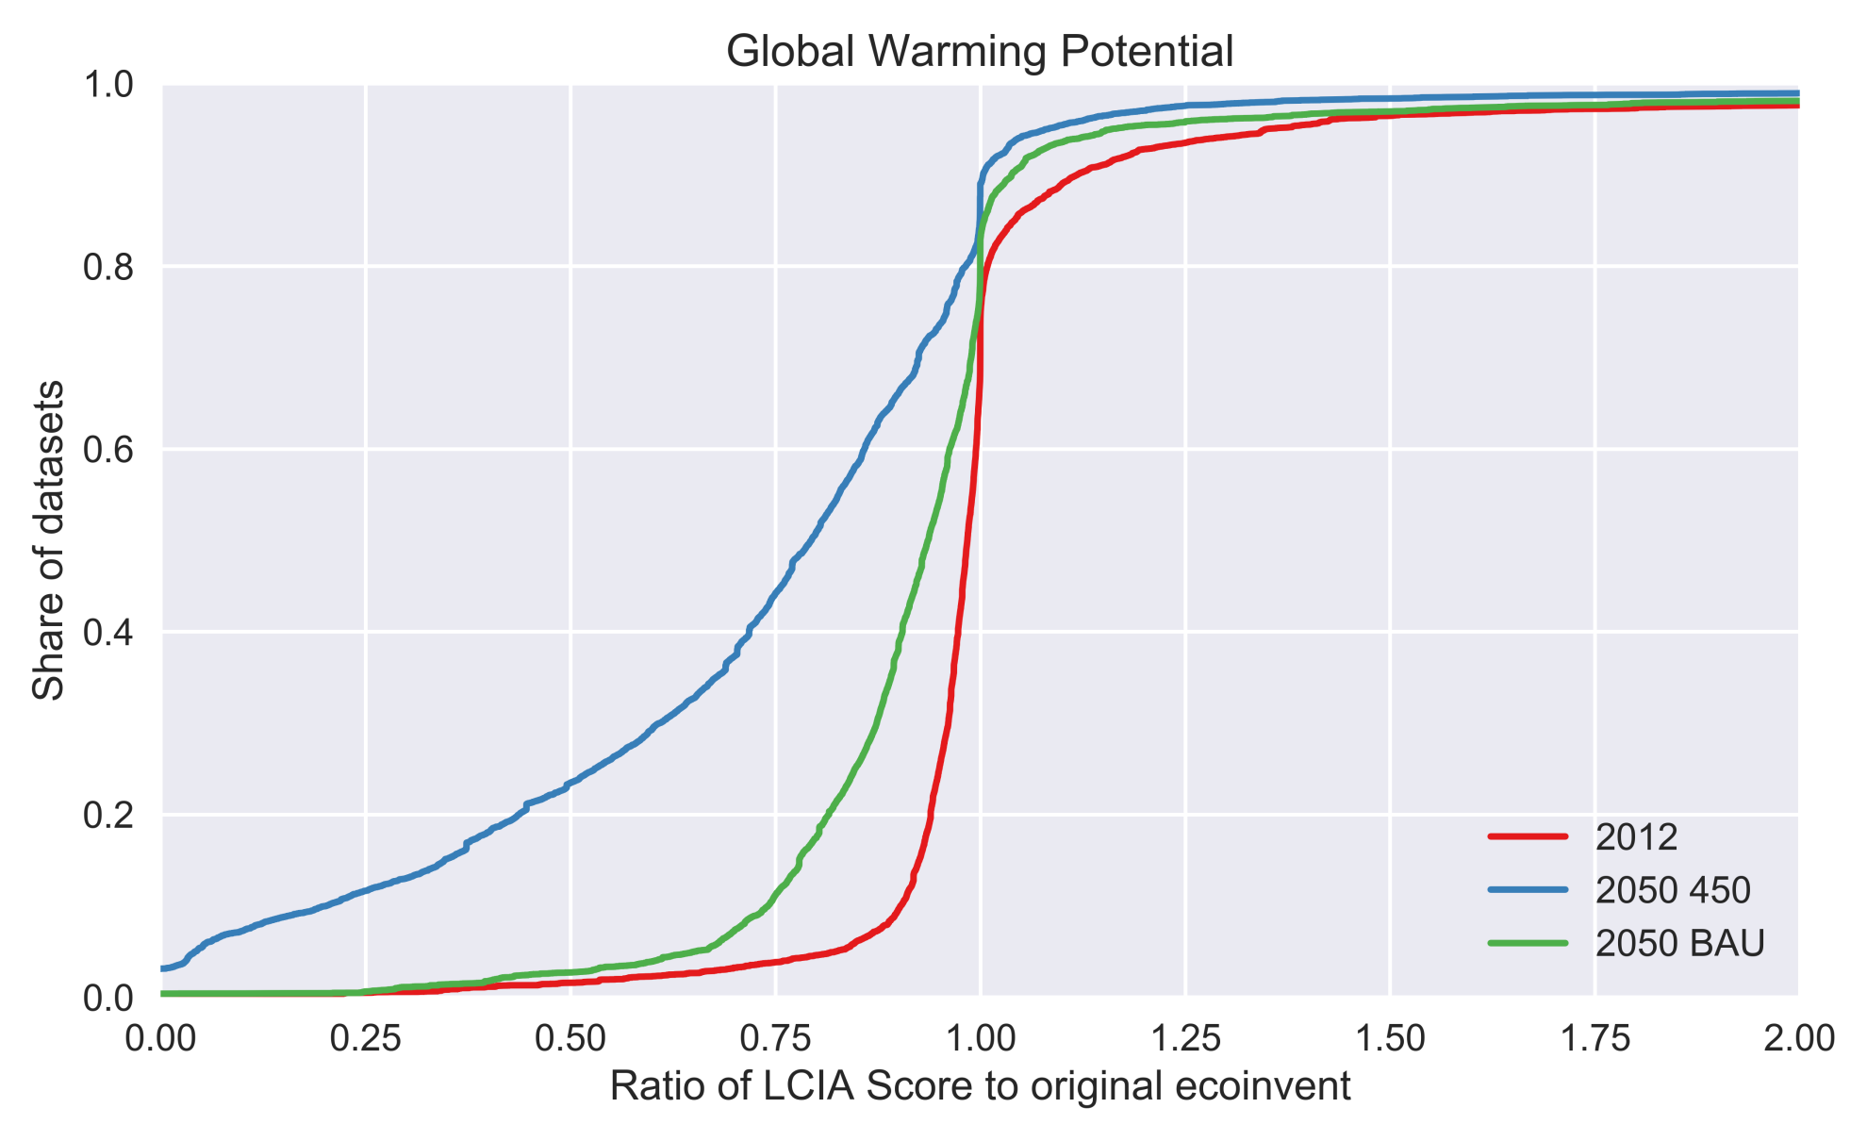
Overall Results

Slide 41
Conclusions
Weaknesses:
Don’t consider improvement of renewables
Some proxies used to complete electricity markets
Some regional data issues – ie Switzerland versus Western Europe
Only electricity sector modified
Strengths:
Software is quite fast
Changes are transparent
Easy to integrate results into Brightway2
Future work:
Compare many scenarios from other data sources
Other sectors?

